Slide 1

"How might we enhance the airport experience with a smart trolley?”
Introducing our innovative product - Smart Trolleys! Designed to enhance the airport experience, these trolleys feature a built-in display screen that provides crucial flight information such as boarding time, gate details, and flight status. The trolley also notifies passengers when it is their boarding time, ensuring a stress-free travel experience. Additionally, the smart trolley offers various entertainment options including charging ports, access to OTT movies and songs, and puzzle games for kids, making wait times enjoyable and productive for passengers of all ages.
GROUP - 5

Slide 2
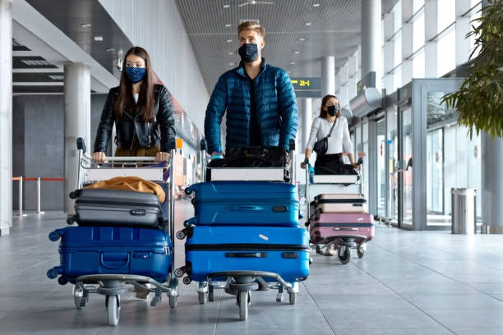
FlightSmart Trolley: Elevating Airport Experiences

Slide 3
Context
1. Stay informed: The smart trolleys come equipped with a display screen that shows essential flight information, helping passengers keep track of their boarding time, gate details, and flight status.
2. Stress-free boarding: Passengers are alerted when it's their time to board, eliminating the need to constantly check the departure boards and ensuring a hassle-free travel experience.
3. Entertainment on-the-go: The smart trolleys offer various entertainment options such as charging ports, access to OTT movies and songs, and puzzle games for kids, making wait times enjoyable and engaging for passengers of all ages.
4. Location assistance: In addition to flight-related information, passengers can use the smart trolleys to check the locations of restrooms, restaurants, and lounges within the airport, helping them navigate the terminal with ease.
5. Directional guidance: The trolleys also provide a directional map to help passengers easily find their way to different facilities and amenities within the airport, making their journey more convenient and efficient.
6. Overall enhancement: With the combination of information display, entertainment features, location assistance, and directional guidance, the smart trolleys aim to elevate the airport experience and improve the travel journey for passengers.

Slide 4
Who are the stakeholders ?
Airport Authorities
Airlines
Passengers
Airport authorities are stakeholders as they are responsible for providing a seamless airport experience to passengers. The introduction of smart trolleys aligns with their goal of enhancing the overall passenger experience within the airport.
They may be involved in the decision-making process regarding the implementation and maintenance of the smart trolley system.
Airport authorities benefit from satisfied passengers who have a positive experience, potentially leading to increased passenger traffic and revenue for the airport.
Airlines have a vested interest in providing a smooth and stress-free travel experience for their passengers. The smart trolleys aid in this goal by offering flight information and entertainment options, contributing to a more pleasant journey for passengers.
Airlines may collaborate with airport authorities or third-party vendors to integrate the smart trolleys into the airport infrastructure and ensure their functionality aligns with airline schedules and operations.
By supporting the use of smart trolleys, airlines can enhance their brand image and potentially improve customer loyalty by providing added value to the passenger experience.
Passengers are direct beneficiaries of the smart trolleys, as they provide valuable flight information, entertainment options, and assistance in navigating the airport facilities.
Passengers can enjoy a more convenient and enjoyable travel experience by using the smart trolleys, leading to higher satisfaction levels and potentially influencing their decision to choose an airport or airline that offers such amenities.
Feedback from passengers on the effectiveness and usability of the smart trolleys can help shape future improvements and modifications to better cater to passenger needs and preferences.

Slide 5
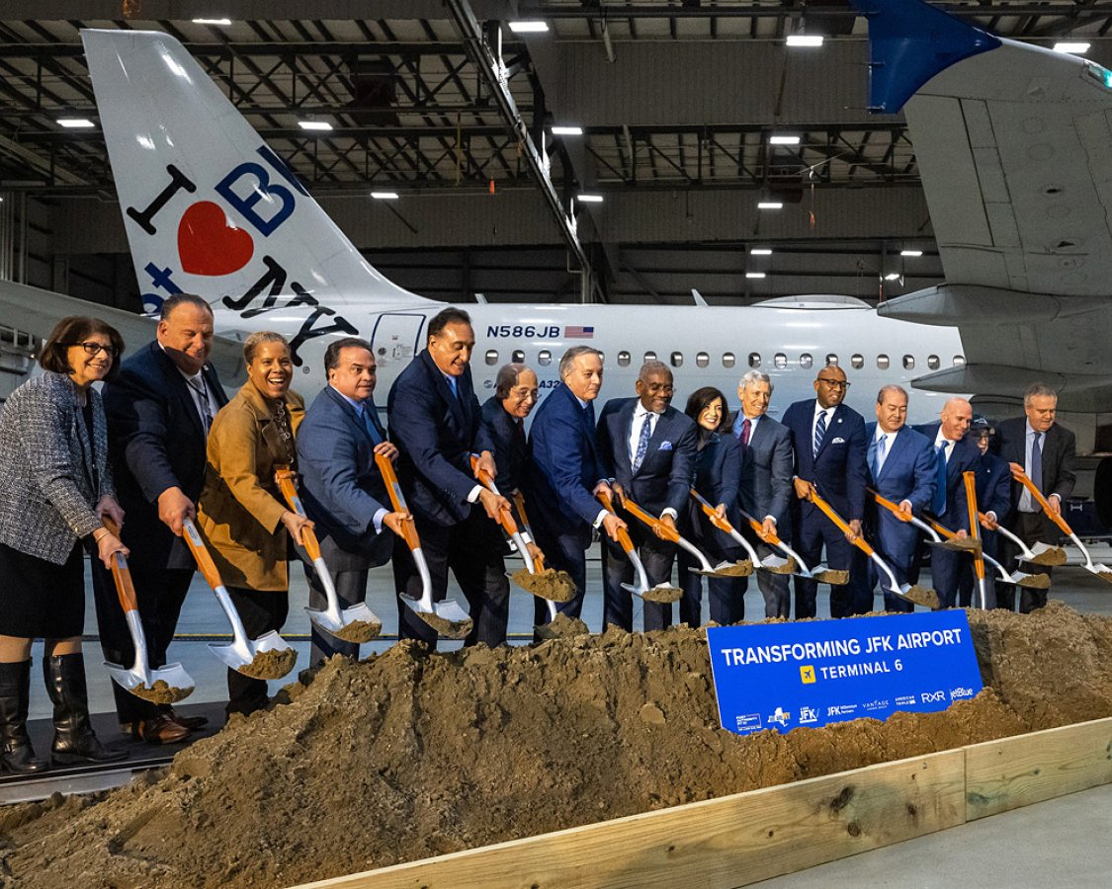

StakeHolders ?
Airport Authorities
Airlines
Passengers

Slide 6
WHO IS THE TARGET ?
Included in the target:
Passengers of all ages (including kids for the entertainment features)
Passengers of varying income levels
Passengers at any location
Passengers of any marriage status
Passengers at any life stage
Not included in the target:
Non-passengers who are not using the airport
Individuals who do not travel through airports
People who prefer not to use technology or entertainment features during travel
Those who do not find flight information display or entertainment options useful in an airport setting
Target: Passengers who travel through airports and are looking for a more convenient and enjoyable airport experience

Slide 7
Existing Products and Our Competitors
In terms of "How Might We" for improving the airport passenger experience, competitors and innovators in the industry are likely exploring solutions related to personalization, seamless connectivity, efficiency, sustainability, safety, and overall passenger satisfaction.
Existing products in this space include a wide range of technology solutions such as mobile apps for flight information and notifications, interactive wayfinding platforms for navigation within airports, baggage tracking systems using RFID technology, airport lounges offering premium services, and entertainment options like virtual reality experiences or in-flight entertainment streaming services. Additionally, there are innovations in biometric authentication, contactless payment, smart luggage solutions, and self-service kiosks aimed at streamlining the airport experience for passengers.

Slide 8
Competitors in the airport technology and passenger experience improvement space can be grouped into the following categories: 1. Airport Information and Communication: - SITA - Amadeus - FlightAware 2. Passenger Communication and Engagement: - GateGuru - TripIt by Concur - LoungeBuddy 3. Airport Navigation and Wayfinding: - IndoorAtlas - AirPortr - Pointr
4. Baggage Tracking and Handling:
- SITA BagJourney
- RFID Global Solution
- Siemens Postal, Parcel & Airport Logistics
Passenger Entertainment and Services:
- OTG Management
- SSP America
- Paradies Lagardère
OUR COMPETITORS

Slide 9
Competitors in existing technology domain
Companies trying to solve the same "How Might We" of improving airport logistics and enhancing passenger experience through smart trolleys may include technology startups, airport management companies, and transportation companies such as:
Uber
Lyft
Waymo
EasyMile
Hyperloop Transportation Technologies
Existing products in this space include smart trolleys with features such as autonomous navigation, real-time tracking, smart sensors for collision avoidance, built-in charging stations, and integration with airport systems. These products aim to streamline baggage handling, reduce passenger wait times, and improve overall airport operations.

Slide 10


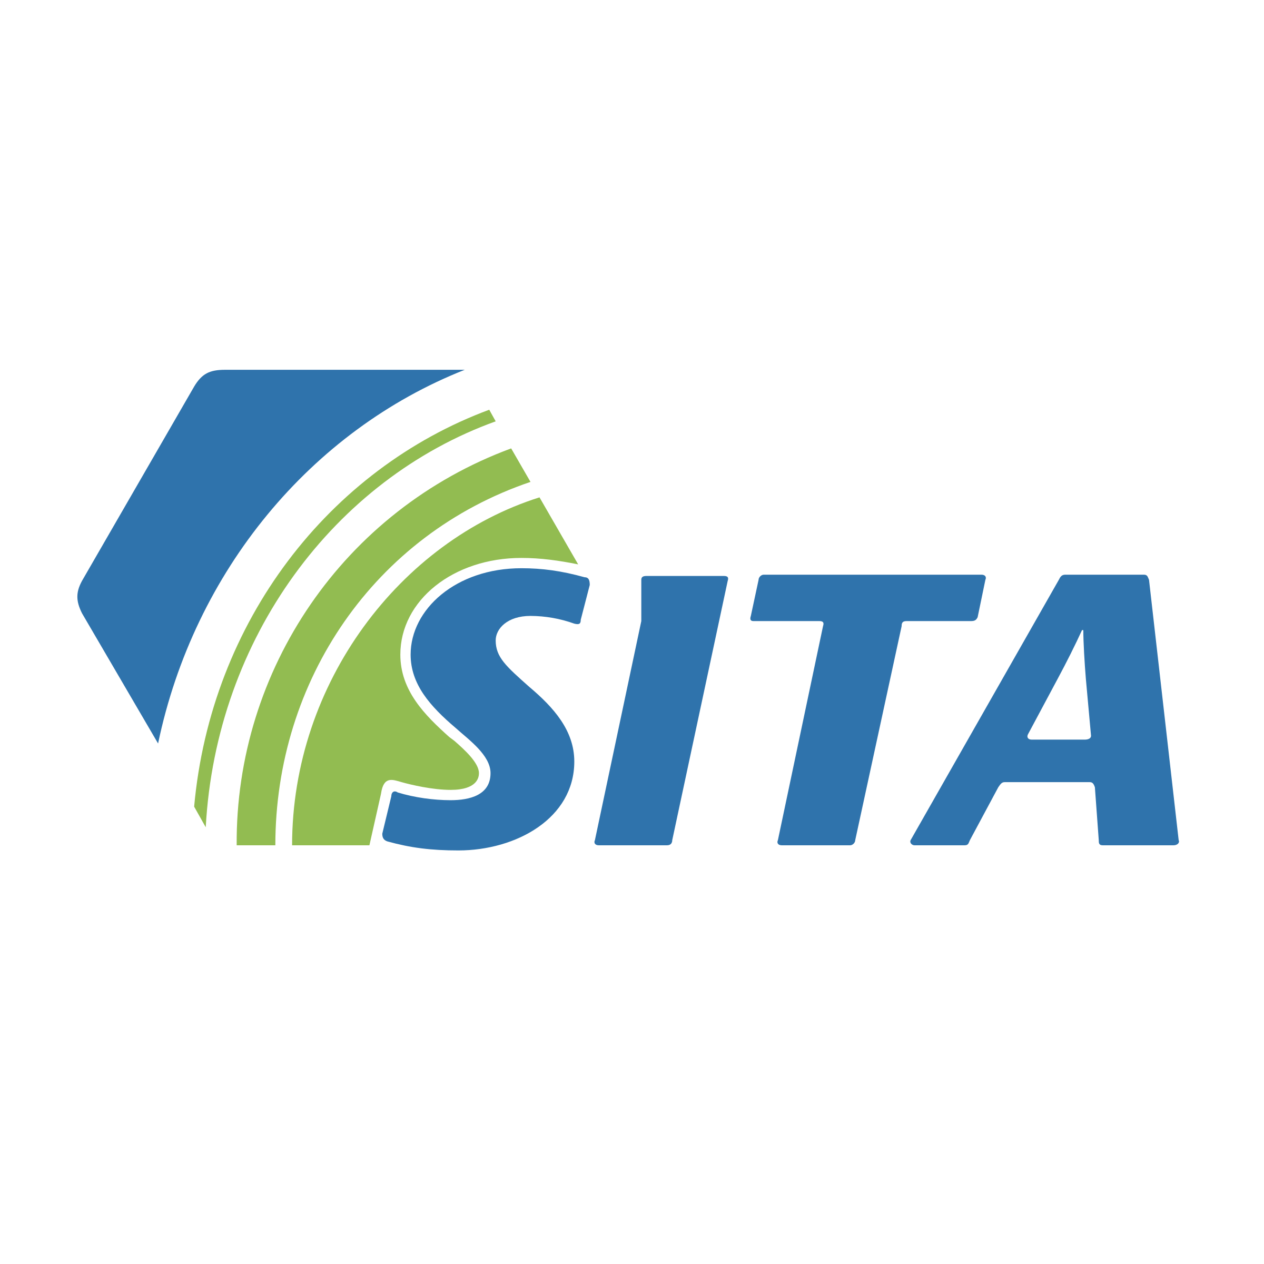


OUR COMPETITORS

Slide 11
How is our product different from others?
Our proposed smart trolley concept differentiates itself from existing products in the airport technology and passenger experience improvement space by offering a comprehensive, all-in-one solution that integrates multiple features and services into a single device. Here are some key ways in which your product could stand out from competitors:
Consolidation of Features: Unlike existing products that offer separate apps or services focusing on specific aspects of the airport experience, your smart trolley combines multiple functionalities into one centralized platform. This simplifies the user experience and eliminates the need for passengers to juggle between various apps or devices.
Enhanced Convenience: By providing a seamless and convenient way for passengers to access flight information, navigate the airport, track baggage, communicate with airlines, and access premium services all in one place, your smart trolley streamlines the travel experience and reduces the hassle associated with airport navigation.
Efficiency and Time-Saving: The integration of multiple features into a single device can save passengers time and effort by providing quick and easy access to essential services. This can lead to smoother travel experiences, shorter wait times, and improved overall efficiency for both passengers and airport personnel.

Slide 12
4. Improved Connectivity and Engagement: Your smart trolley could also offer enhanced connectivity options such as Wi-Fi, Bluetooth, and mobile charging capabilities to keep passengers connected and engaged throughout their journey. This could include personalized notifications, promotions, and recommendations based on passenger preferences and travel patterns.
5. Innovation and Differentiation: Introducing a novel concept like a smart trolley to the market demonstrates innovation and creativity in addressing common challenges faced by travelers. By offering a unique solution that combines technology, convenience, and passenger-centric design, your product can set itself apart from traditional airport services and competing offerings.
Overall, your smart trolley concept has the potential to disrupt the airport technology and passenger experience space by providing a holistic and integrated solution that caters to the diverse needs of modern travelers. By offering a seamless, efficient, and engaging experience, your product can create added value for passengers and contribute to a more enjoyable and stress-free travel experience.
TIME IS MONEY

Slide 13
Current Situation/Problem Flow at Airports:
1. Flight Information:
- Passengers typically need to check their flight information (gate, boarding time, delays, etc.) on airport screens, airline apps, or by asking staff.
- Lack of centralized and real-time updates can lead to confusion and missed information.
2. Baggage Handling:
- Passengers may need to wait in long lines at baggage drop-off counters and baggage claim areas.
- Baggage tracking systems may not be easily accessible to passengers, leading to uncertainty about the status of their luggage.
3. Airport Navigation:
- Navigating through the airport can be challenging, especially for first-time travelers or those unfamiliar with the layout.
- Signage may not always be clear, and airport maps or directories may not provide detailed guidance.

Slide 14
"Transforming the airport experience from fragmented to seamless”
4. Communication:
Passengers may struggle to communicate with airline representatives for queries, assistance, or updates.
Language barriers or overcrowded airline desks can hinder effective communication.
5. Premium Services:
Accessing airport lounges, premium services, or special amenities may require separate bookings or memberships.
Finding information about available services and their locations can be time-consuming.
6. Efficiency and Convenience:
Overall, the airport experience can be fragmented and lacking in efficiency, with passengers needing to use multiple apps, devices, or sources of information to navigate through various aspects of their journey.
By addressing these pain points and offering a consolidated solution through the smart trolley concept, passengers can benefit from a more seamless, efficient, and enjoyable airport experience that caters to their diverse needs and preferences.

Slide 15
How might we resolve the problem’s faced by passengers on airport ?
How might we improve real-time communication of flight information to passengers to reduce confusion and enhance their travel experience?
This was selected as it addresses a key pain point for passengers and has the potential to significantly impact their overall journey.
How might we streamline baggage handling processes to minimize wait times and improve luggage tracking for passengers?
Baggage handling is a common frustration for travelers, and focusing on this aspect can lead to tangible improvements in the airport experience.
How might we enhance airport navigation for passengers through innovative technology solutions to make their journey more seamless and stress-free?
Navigating airports can be a source of anxiety and confusion for many passengers, so improving this aspect aligns with the goal of creating a smoother travel experience.

Slide 16
These narrowed down "How Might We" statements address crucial pain points within the airport experience and offer opportunities for improvement that can have a significant impact on passenger satisfaction and overall journey efficiency.
4. How might we facilitate efficient communication between passengers and airline staff to address queries and provide timely updates?
Effective communication is essential for a positive airport experience, and finding ways to streamline this process can lead to better customer satisfaction.
5. How might we simplify access to premium airport services and amenities for passengers, making it easier for them to enjoy these offerings during their journey?
Enhancing the accessibility of premium services can add value to the passenger experience and contribute to a more enjoyable and comfortable travel experience.

Slide 17
Other Problems Faced in Airport
Limited Amenities: Some airports may lack sufficient amenities, such as rest areas, charging stations, or comfortable lounges, making it challenging for passengers to relax.
Limited Food Options: Limited or expensive food choices within the airport can be frustrating for passengers, especially those with dietary restrictions.
Unpleasant Restrooms: Poorly maintained or unclean restroom facilities can contribute to a negative experience for travelers.
Lack of Accessibility: Inadequate facilities for passengers with disabilities can pose challenges and discomfort for individuals with mobility issues.
Flight Overbooking: Experiencing a flight that is overbooked, leading to potential seat reassignments or denied boarding, can be a frustrating experience for passengers.
Uncomfortable Temperatures: Extremes in temperature, whether too hot or too cold within airport facilities, can make waiting areas uncomfortable for passengers.
Currency Exchange Issues: Difficulties in accessing or using local currency due to limited exchange services or unfavorable rates can be a concern for international travelers.
Unreliable Transportation: Inconsistent or delayed airport shuttle services, taxis, or public transportation can cause stress for passengers trying to reach or leave the airport.
Lost or Misplaced Items: Misplacing personal items or having them lost during security checks can be a source of frustration and inconvenience for travelers.

Slide 18
References
1. "Airport Rolling Luggage Cart with USB Charger" - article from Travel + Leisure
2. "The Future of Smart Luggage at Airports" - video by CNBC
3. "How Smart Trolleys are Revolutionizing Air Travel" - article from Forbes
4. "The Benefits of Smart Carts in Airports" - video by CNN Travel
5. "Smart Cart Technology: Enhancing the Airport Experience" - article from Airport Technology.
YouTube Link - https://www.gmrgroup.in/blog/Hyderabad-airport-goes-smart-with-indias-first-Iot-enabled-baggage-trolleys.aspx

Slide 19
Thank You

